Slide 1
From Stage to Screen A Theatrical Look at Early Thanhouser Films
"Gesture is nature’s language and makes its way to the heart without utterance of sound.”
Cyprienne from the play Divorçons by Victorien Sardou (1882).
Presented by Ned Thanhouser at WSS XI
Notes:
Although the Biograph Studios (with Griffith), the Edison, Kalem, and Lubin companies’ films are the better known to historians from this early period of filmmaking, it was the Thanhouser Film studio that best illustrates the transition from live performance to filmed melodrama. In the silent era, it was the actor’s “natural gestures” on screen that had to convey the emotion of the characters without the use of spoken dialog.

Slide 2
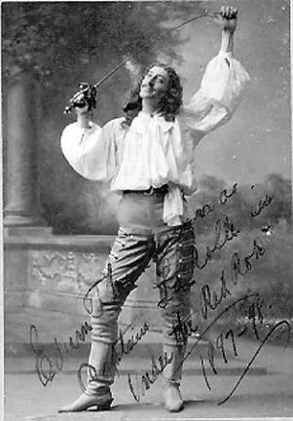
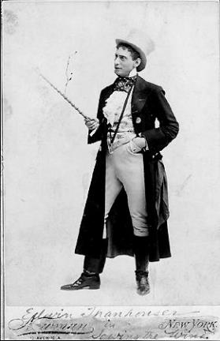
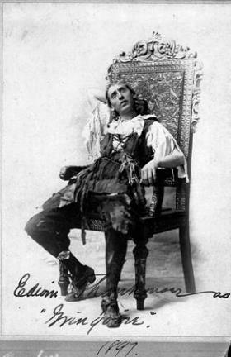
Edwin Thanhouser On the Stage (1893 - 1898)
Notes:
First, some background on the Thanhouser studio. At the close of the 19th century Edwin Thanhouser had a career as a legitimate stage actor with Alessandro Salvini’s traveling company for about 4 years starting in 1883.

Slide 3
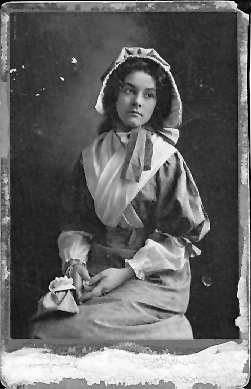
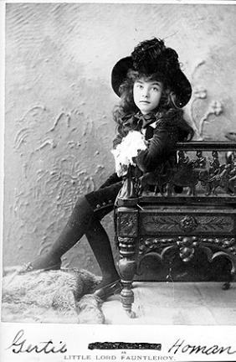
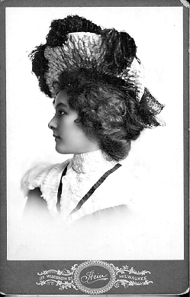
Gertrude Homan On the Stage (1888 to 1900)
Notes:
Gertrude Thanhouser was an experienced stage actress famous on Broadway, known as “Little Gerdi Homan.”

Slide 4
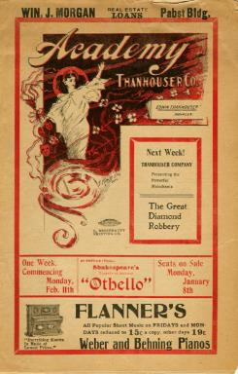
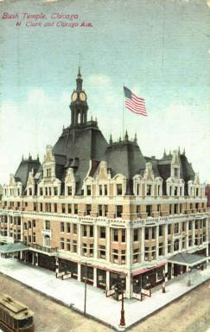
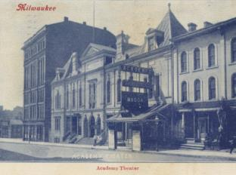
Edwin & Gertrude Thanhouser Theater Managers (1899 - 1909)
Milwaukee, WI
Chicago, IL
Notes:
After Salvini’s untimely death in 1896, Edwin was hired by the Schubert brothers of Broadway fame to manage the Academy of Music stock theatre in Milwaukee, Wisconsin.
Edwin hired Gertrude in 1899 for summer stock, they were married in 1900.
Edwin and Gertrude unsuccessfully moved to Chicago in early 1909 to manage the Bush Temple Theatre.

Slide 5
Edwin Thanhouser Interviewed
“I saw its possibilities. I became filled with the idea that I could produce better pictures than a majority of those I had seen. The idea became a determination. I studied the situation on the market.”
The Motion Picture World (1910)

Slide 6
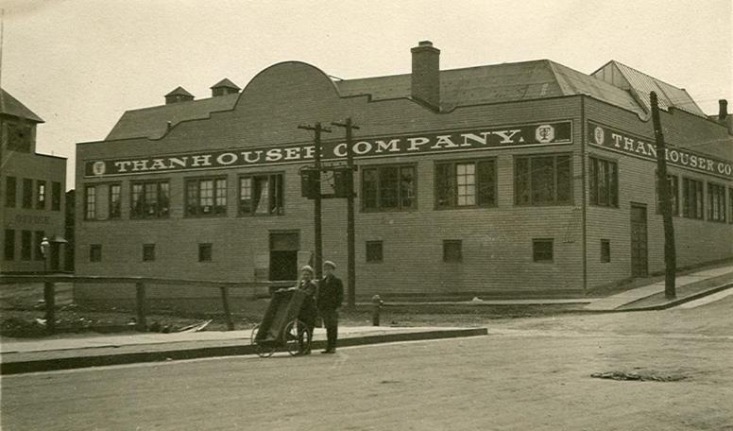
First American Film Studio Led by Theatrical Veterans
Notes:
Edwin and Gertrude observed the advent of motion pictures as the future of entertainment in America. In late 1909 they moved their family to New Rochelle, New York, where, with brother-in-law and newspaper man Lloyd Lonergan, they established a film studio in a former roller-skating rink with Edwin managing the business, Lonergan writing scenarios, and Gertrude casting and editing films. It was noted by the press at that time that this was the first American motion picture studio to be led by theatrical veterans!

Slide 7
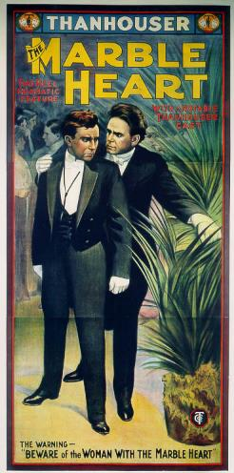
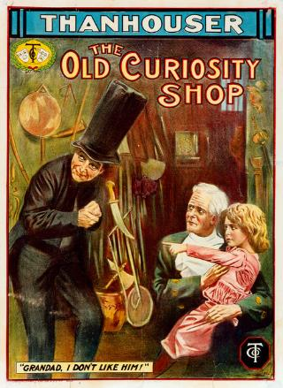
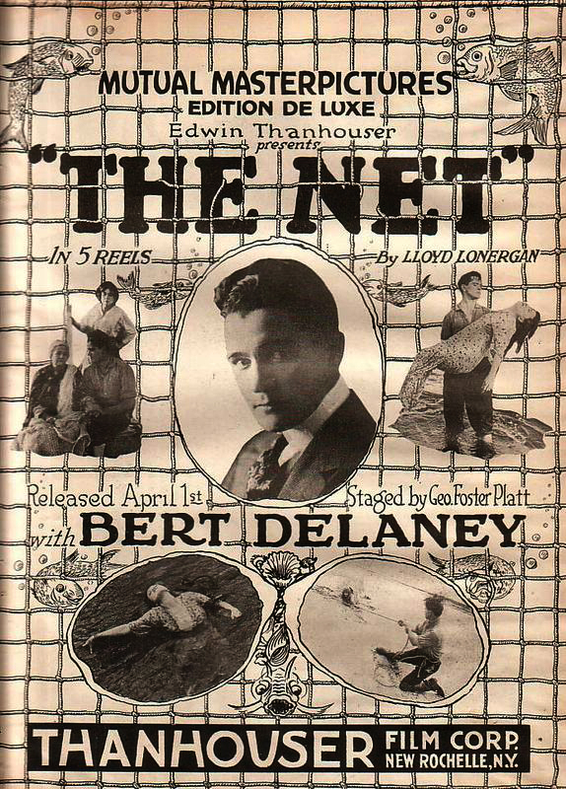
1,086 Films Released 1910 → 1917
1916
Five Reels
1910
One Reel
1913
Two Reels
Notes:
Their films were drawn from classic novels, Dickens especially, and the stage – Shakespeare, Ibsen, comedy, and melodrama - and a substantial number of the films produced by the company between 1910 -1917 were original melodramas written by Lonergan, many were mysteries, detective thrillers, and domestic dramas.

Slide 8
Thanhouser’s Strategy for Success
Hire seasoned theatrical veterans!
Yale Boss (The Actor’s Children): Since age nine
Fred Santley (The Actor’s Children): Since age five
William Russell (Little Girl Next Door): Since age eight
William Garwood (Little Girl Next Door): Since age 19
Barry O’Neil (Director): With Thanhouser since 1907
Lucius Henderson (Director): Actor since 1884 at 23
Notes:
Edwin and Gertrude’s years of acting on the stage combined with over a decade of managing a stock company in Milwaukee and Chicago positioned them for success in the new motion picture industry. They hired actors and directors with theatrical backgrounds who where trained in the art of performance with an emphasis on gestures to convey emotion and action.

Slide 9
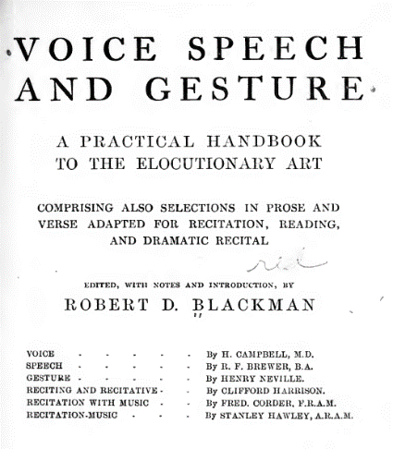
Theatrical Handbook from 1912
Notes:
From Edwin and Gertrude’s years of performing on the stage, we will see how their craft was incorporated into Thanhouser films demonstrating the transfer of standardized gestures from late-Victorian theatre as codified by Blackman in this handbook. Once used for live stage performance, these visible elements are distinctly present in Thanhouser films and are preserved evidence of a theatre we thought lost.

Slide 10
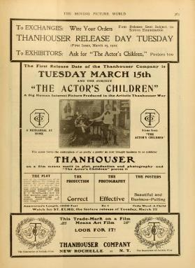
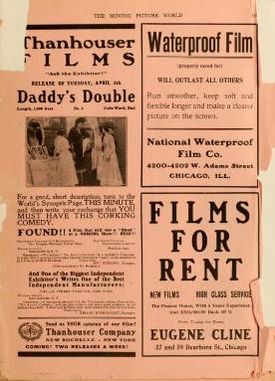
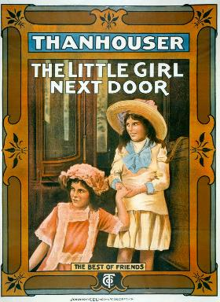
The Actor’s Children March 15, 1910
Three Early Thanhouser Films
Daddy’s Double
April 5, 1910
The Little Girl Next Door
Nov. 1, 1912
Notes:
Today, I examine on three early films from 1910: Thanhouser’s very first release THE ACTOR’S CHILDREN, and the company's 4th release DADDY’S DOUBLE. These two films clearly show the transference of stage acting protocols to on screen performances.

Slide 11
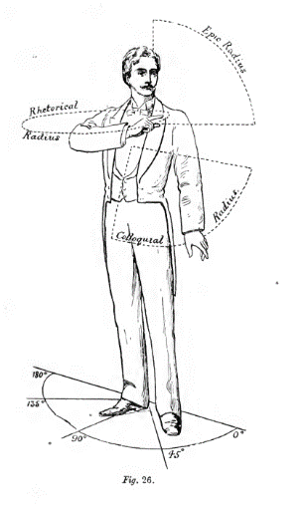
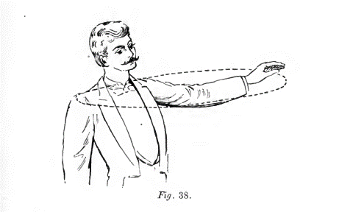
The Stroke of Gesture
Epic (Above the shoulder)
Rhetorical (Level with shoulder
Colloquial (Below shoulder)
The Rhetorical Action: “Go there”
Notes:
From the chapter “Gesture” by Henry Neville, we learn of the POSITIONS AND MOTIONS OF THE HANDS,
ARMS, AND SHOULDERS. The Rhetorical: “Come here” or “Go there.” “The stroke of the gesture
should be to the eye what the inflexions of the voice are to the ear.”

Slide 12
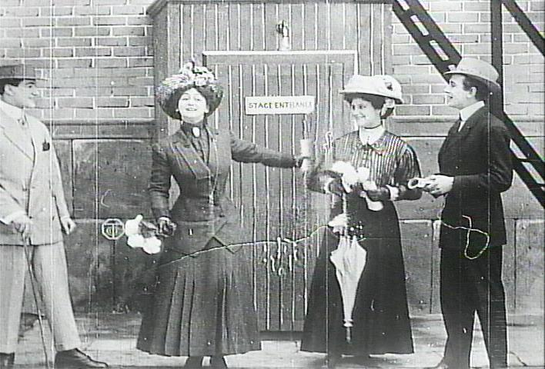
The Actor’s Children (1910)
Notes:
From Thanhouser’s very first release, The Actor’s Children, in the very first scene we see the adoption of stage techniques, here a rhetorical arc action by the woman center screen as she dismisses her companions.

Slide 13
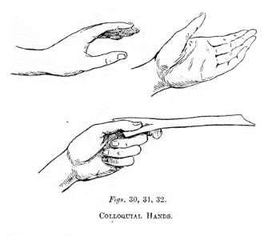
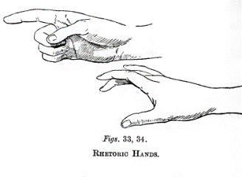
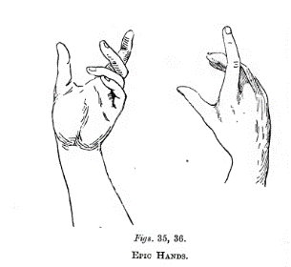
The Hands
" The hands assist the speaker." -Vossius.
" Without the hand, no eloquence." -Cresollius.
"The hand may properly be called a second tongue.” -Artemidorus.
Notes:
As pointed out by Neville, the position of the hands are used to emphasize the arc of the gesture
Palms always up for appeals, supplications, requests. Palms down for warnings, deprecation, repulsion.

Slide 14
The Actor’s Children (1910)
Notes:
Here from THE ACTOR’S CHILDREN, we see the father, Frank Crane, in mid-arc with classic colloquial gesture and hand position

Slide 15
The Actor’s Children (1910)
Notes:
From The Actor’s Children, we see Yale Boss play-acting stabbing his sister with an epic hand gesture and position

Slide 16
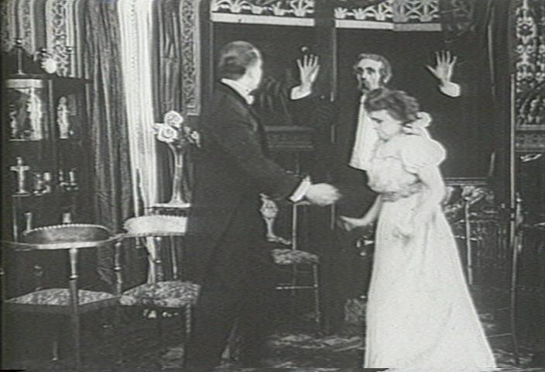
Daddy’s Double (1910)
Notes:
Here in DADDY’S DOUBLE from 1910 an epic arc with the hands above the shoulders in response by the father discovering his daughter kissing her beau

Slide 17
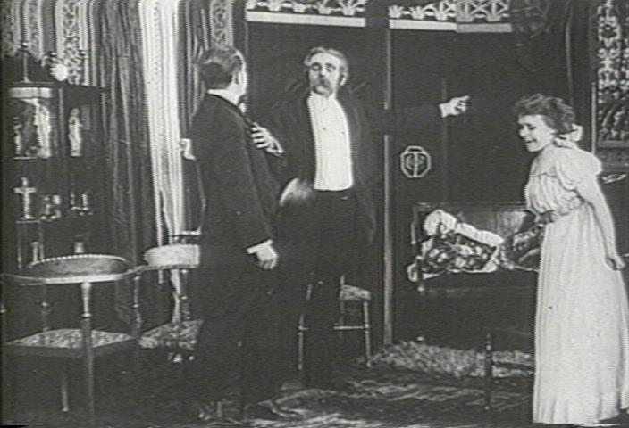
Daddy’s Double (1910)
Notes:
Followed by the father dismissing the suitor, a classic rhetorical arc and hand gesture.
Side note about the TCo logo in background, and copyright issues

Slide 18
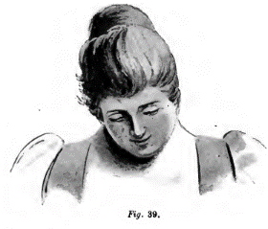
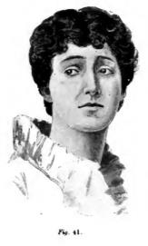
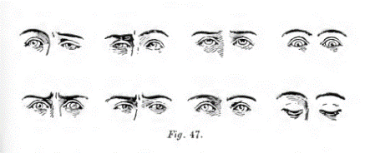
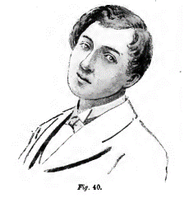
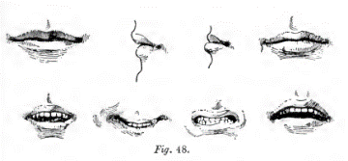
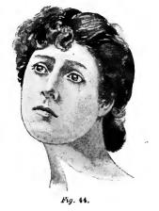
The Head, Face, Eyes, Brows, and Mouth
Notes:
Finally, Neville emphasizes the position of the head, face, eyes, brows and mouth in addition to the arc of gestures

Slide 19
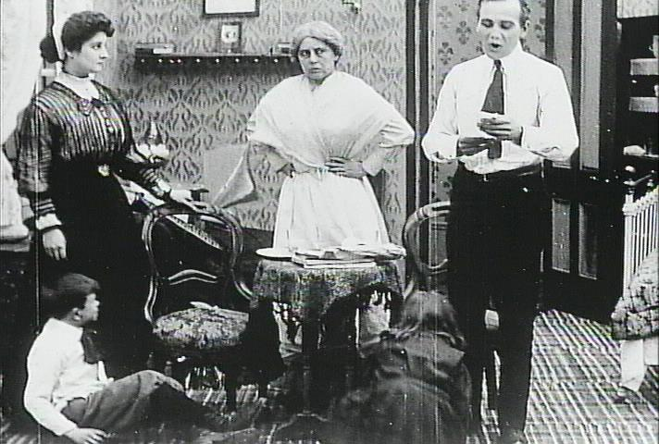
The Actor’s Children (1910)
Notes:
From The Actor’s Children, the land lady is clearly expressing her unhappiness with her eyes emphasize the dismay at the lack of payment for the rent

Slide 20
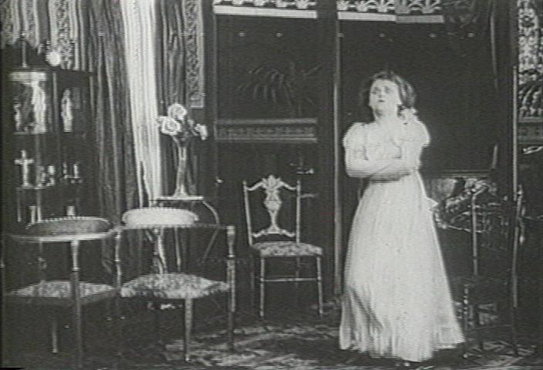
Daddy’s Double (1910)
Notes:
From Daddy’s Double, after the father has dismissed the suitor and left, the uptilted head and crossed arms convey her defiance

Slide 21
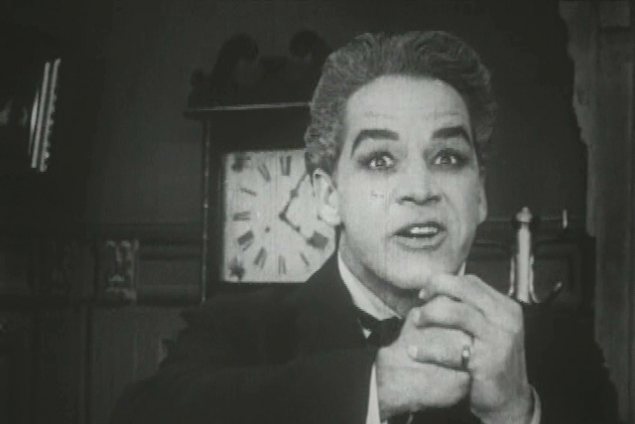
The Little Girl Next Door (1910)
Notes:
William Russell shows rage as he schemes to ruin the man responsible for his daughter’s death in The Little Girl Next Door (1912)

Slide 22
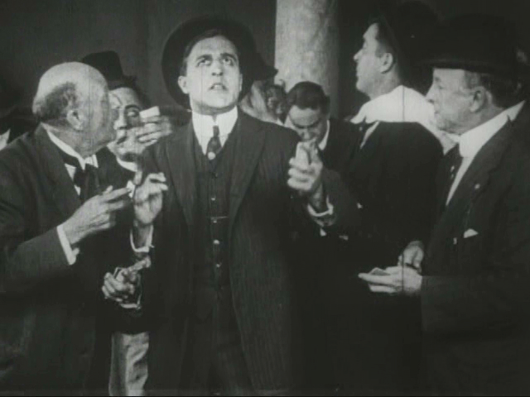
The Little Girl Next Door (1910)
Notes:
William Garwood learns of his loss in the stock market orchestrated by William Russell in The Little Girl Next Door (1912)

Slide 23
Thanhouser’s Strategy Success
“of the independents…Thanhouser pictures, of course, rank highest. Indeed, the manner in which this new company without previous experience in picture making has developed in quality, shows what may be done in film manufacture when intelligence and energy are employed.”
The Spectator, The New York Dramatic Mirror (Summer, 1910)
Notes:
"The Spectator," the otherwise unidentified editor of the motion picture section of The New York Dramatic Mirror, the weekly journal primarily devoted to the opposing Patents Company firms.

Slide 24
Thanhouser’s Fleeting Success
Early Success Was Not Sustainable
Audiences Demanded More Than Theatrics
Naturalistic Acting
Elaborate Production Values
Greater Character Development
Feature Length Films
Emergence of Star System
Industry’s Move to West Coast
Edwin Thanhouser’s Mutual Contract Expired
Financial Success Led to Retirement

